Slide 1
Category review: Chips
January 2021
Retail Analytics

Slide 2
Notes:
To view Privacy video explaining how important data privacy is to Quantium, please click here: https://www.youtube.com/watch?v=Zq1QDAkoRzU
or here Q:\Company Reference\Brand & Design\Brand videos\Q Privacy.mp4
At Quantium, we believe that data is the behavioural footprint of humanity and that it has to be treated with the utmost care and responsibility.
Histories, attitudes, indeed lives are stored within it in ways that aren’t always apparent – and that’s what makes its potential so powerful.
To work with it responsibly, sensitively, we set ourselves the highest data privacy protection and governance standards.
We have spent 17 years perfecting privacy-by-design and secure-by-design principles. Central to this is not holding any personally identifiable information about people –
we neither receive it, and put the necessary protections in place to be unable to decipher it.
Every aspect of handling data is safeguarded: from its de-identification, to its encryption – data security is paramount and of the highest grade.
We pride ourselves on gaining the trust of iconic organisations around the world through years of securely working with their data,
and in turn the trust that builds with their stakeholders.

Slide 3
Executive summary
01
Chips Category Review
Young and middle-aged singles and couples in the mainstream demographic spend the most money per purchase in terms of chips.
(Budget) have the highest purchase frequency, followed by Young Singles/Couples (Mainstream) and finally Retirees (Mainstream), who together account for 25% of sales revenue.
The most popular brand of kettle in every store is Chips Brand.
Doritos is the only segment in which young and middle-aged singles and couples make the most purchases, with Smiths dominating the other segments.
The most popular chip size for all categories is 175 gr, followed by 150 gr.
Before Christmas, there is a significant surge in chip transactions, which might be advantageous with the aid of special offers.
02
Store Analysis
In comparison to the control store, the trial stores 77 and 86 experienced a sizable rise in both total sales and the number of customers.
Trial store 88 also had an increase, but not to the same extent as stores 77 and 86.

Slide 4
01
Category

Slide 5
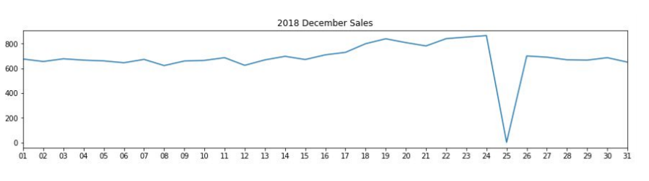
Christmas day is the day with no transactions because the store is closed; consequently, there was a drop in sales on December 25 because the stores were closed.
As Christmas day draws near, sales gradually grow. On New Year's Eve, they resume their early December levels.

Slide 6
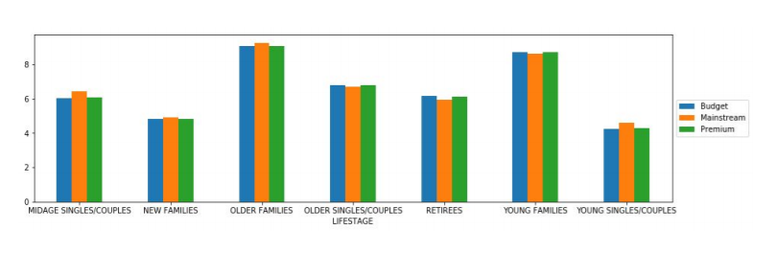
Budget - older families, Mainstream - young singles/couples, and Mainstream - retirees accounted for the majority of sales. generating 25% of the entire sales revenue.
The segments with the highest average purchase units per unique client are Older and Young Families

Slide 7
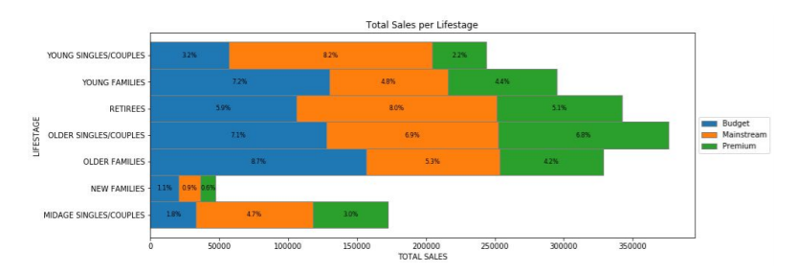
Budget - older families, Mainstream - young singles/couples, and Mainstream - retirees accounted for the majority of sales. Overall, older clients spend more money than younger ones. Customers who are not premium purchase more than those who are..

Slide 8
02
Trial store performance

Slide 9
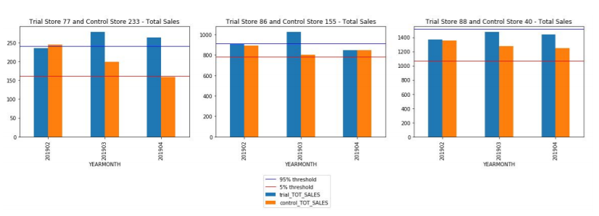
We can see that Trial store 77 sales for Feb, March, and April exceeds 95% threshold of control store. Same goes to store 86 sales for all 3 trial months.
Whereas trial store 88 sales increase is insignificant.

Slide 10
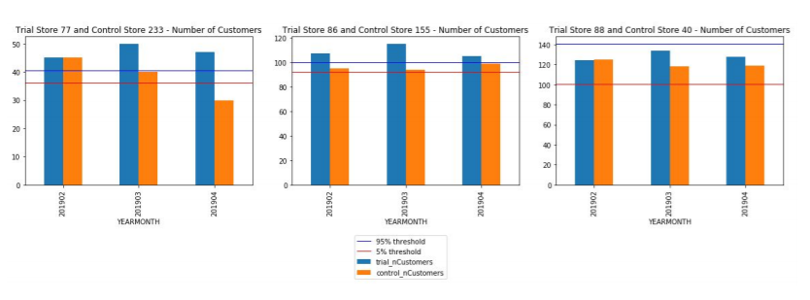
Trial store 77: Control store 233
Trial store 86: Control store 155
Trial store 88: Control store 40
Both trial store 77 and 86 showed significant increase in Total Sales and Number of Customers during trial period. But not for trial store 88. Perhaps the client knows if there's anything about trial 88 that differs it from the other two trial.
Overall the trial showed positive significant result.

